Slide 1


CS 235: User Interface Design February 19 Class Meeting
Department of Computer Science San Jose State University Spring 2015 Instructor: Ron Mak
www.cs.sjsu.edu/~mak

Slide 2
Schedule for Usability Testing
Thursday, February 26
Innovative Designers
Team Four
Thundercats
Tuesday, March 3
Unknown
Uxability
X Factor

Slide 3
Usability Testing Tips
Give your tester two significant tasks to do.
Or, two testers, one task each.
It should be a significant task for your application, such as booking a hotel room online.
OK to tell the tester that some parts don’t work yet.
The facilitator should maintain an ongoing conversation with the tester.
Ask the tester to think out loud.
“What do you think this application is for?”
“What can you can do on this page?”

Slide 4
Usability Testing Tips, cont’d
Do not hand-hold the tester.
Wrong: “Now press this button.”
Right: “What should you do next?”
Provide more explicit help only if the tester is truly stuck or confused.
You want to see how a typical user will behave, and you won’t be sitting next to every user.
Your goal is to uncover UI/UX problems.
Do not get frustrated with the tester.
Tester confusion ➔ what needs to be improved!

Slide 5
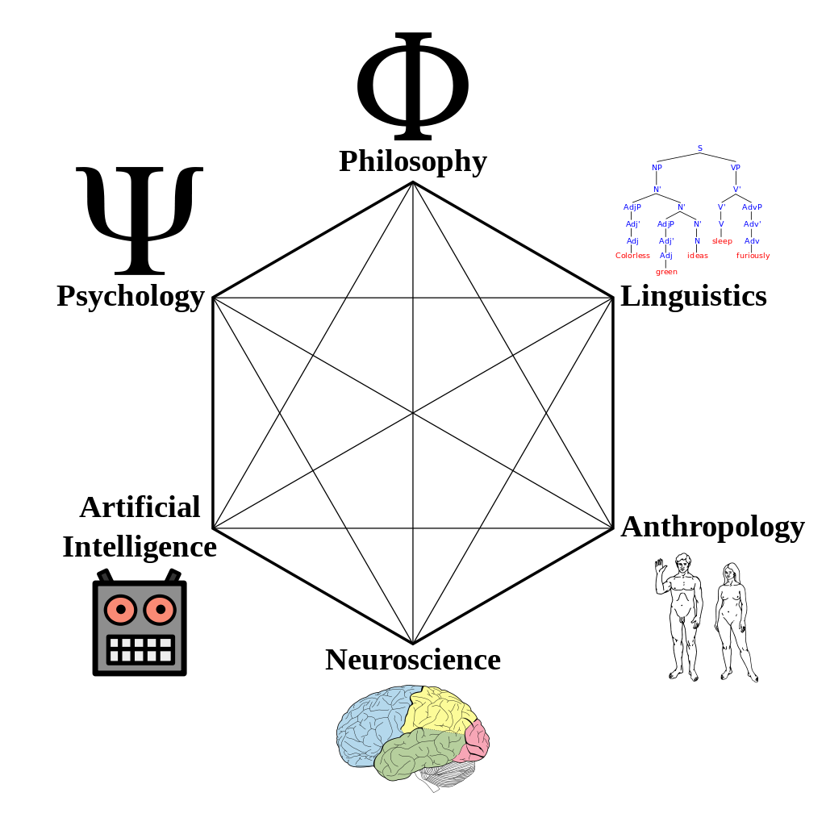
Cognitive Science
The interdisciplinary study of the mind, intelligence, and behavior.
How does the mind process information?
perception
language
memory
reasoning
emotion
http://en.wikipedia.org/wiki/Cognitive_science

Slide 6
Perception Can be Biased
What we see is actually an “alternate reality”.
Heavily biased by:
The past: our experience
The present: the current context
The future: our goals _

Slide 7

Bias by Experience: Priming
Suppose you own an insurance company.
There is a small complex of office buildings that you want to insure, so you get an outline map of the buildings:
Designing with the Mind in Mind, 2nd ed. by Jeff Johnson
Morgan Kaufmann, 2014

Slide 8
Bias by Experience: Priming, cont’d
Suppose you own an insurance company.
You want to design a large sign to advertise your life insurance policies:
Designing with the Mind in Mind, 2nd ed. by Jeff Johnson
Morgan Kaufmann, 2014

Slide 9
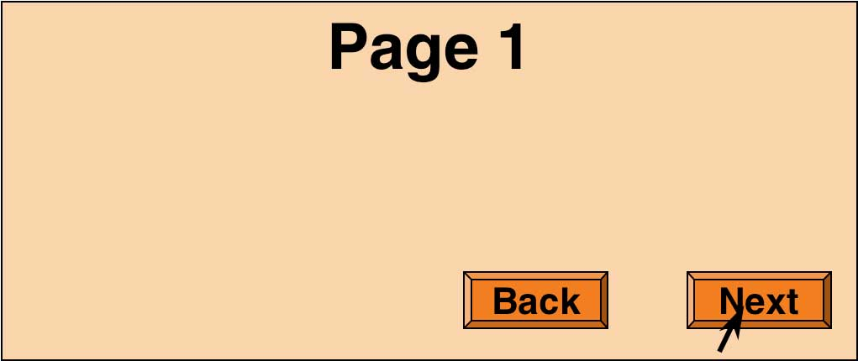



Bias by Experience: Familiar Patterns
We expect and desire consistency.
Designing with the Mind in Mind, 2nd ed. by Jeff Johnson
Morgan Kaufmann, 2014

Slide 10
Bias by Experience: Context
What is the meaning?
Fold napkins.
Polish silverware.
Wash dishes.
French napkins.
Polish silverware.
German dishes.

Slide 11
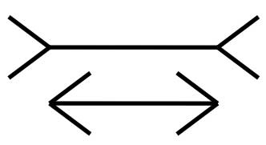
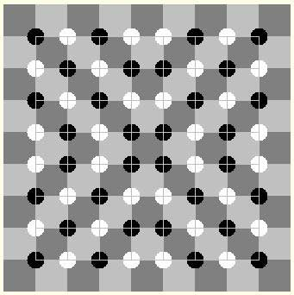
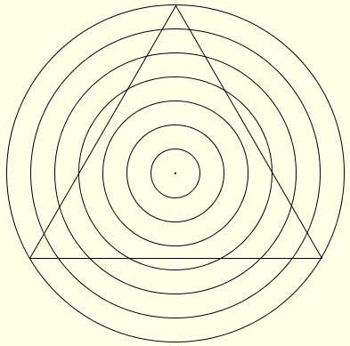
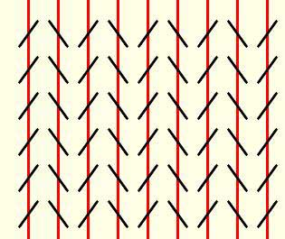
Bias by Experience: Context, cont’d
Designing with the Mind in Mind, 2nd ed. by Jeff Johnson
Morgan Kaufmann, 2014

Slide 12
Perception Biased by Goals
Our goals influence where we look.
Our goals sensitize us to what we see.
You’re on the home page of the University of Canterbury.
You want information about financial support for postgraduate students in the computer science department.
How would you find it?

Slide 13
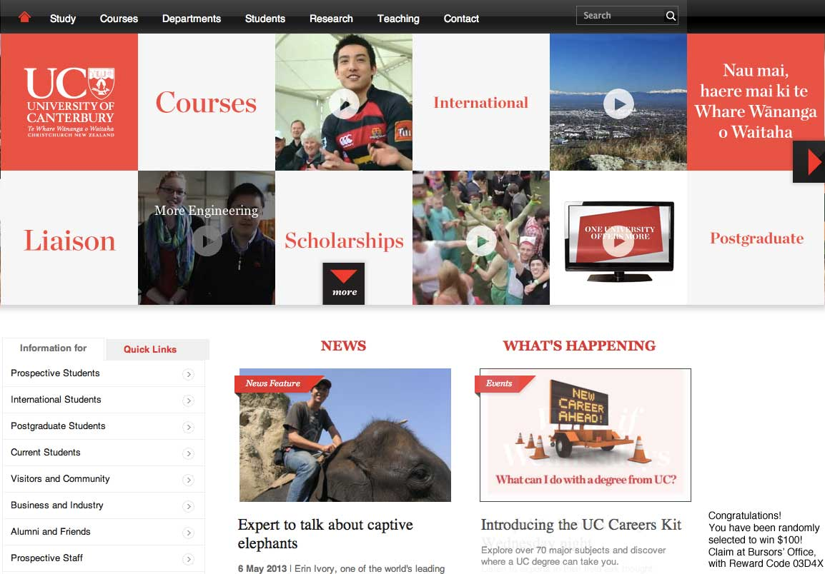
Perception Biased by Goals, cont’d
Did you notice this?
Designing with the
Mind in Mind, 2nd ed. by Jeff Johnson
Morgan Kaufmann, 2014

Slide 14
Perception and UI Design
Take biased perception into account!
Avoid ambiguity.
Make sure all users interpret your design in the same way.
Be consistent.
Place controls in consistent locations.
Use consistent shapes, colors, fonts, etc.
Understand goals.
Different users may have different goals.
Ensure your UI clearly directs users to the right goal.

Slide 15
Perception Video
https://www.youtube.com/watch?v=9Il_D3Xt9W0

Slide 16
Long-Term Memory
Perceptions enter through our visual, auditory, olfactory, gustatory, and tactile sensory systems.
Long-term memory is recorded in our brains by changes in the neurons that are involved in a neural activity pattern.

Slide 17
Long-Term Memory: Recognition vs. Recall
Recognition
New perceptions similar to previous ones reactivate the same pattern of neurons.
Recall
Other brain activity causes a pattern of neurons to reactivate.

Slide 18
Short-Term Memory
A combination of phenomena involving:
perception
attention
retrieval from long-term memory
Working memory
The main component of short-term memory.
The tiny subset of all available information from our perceptual systems and our long-term memory that we are aware of right now.

Slide 19
Working Memory Analogy
Long-term memory is a dark warehouse full of stuff.
Doors and windows represent our perceptual senses.
Working memory consists of whatever is lit up by a few searchlights.
The searchlights move to shine on different objects as our attention (what we are aware of now) shifts.

Slide 20
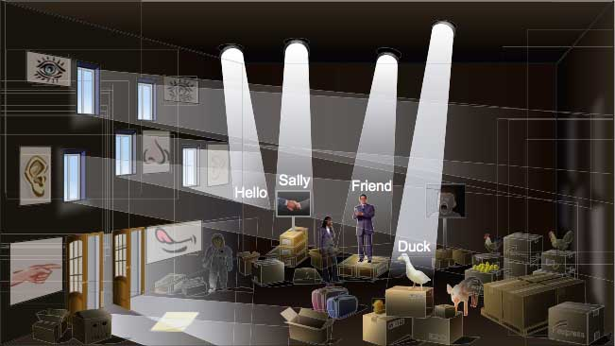
Working Memory Analogy, cont’d
Working memory is
not a memory store!
Designing with the Mind in Mind, 2nd ed. by Jeff Johnson
Morgan Kaufmann, 2014

Slide 21
Attention and Working Memory
Attention is highly focused and selective.
Objects and events related to our current goals.
Movement near or toward us.
Threats, faces, food, sex.
Capacity of attention
Old theory: 7 plus or minus 2
Actual average capacity: 4 plus or minus 1
Volatility of working memory
Easy to forget goals and details.

Slide 22
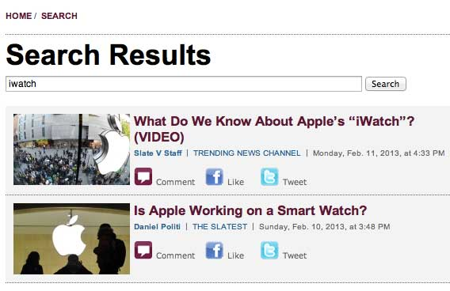
Working Memory and UI Design
Remind users what their search terms were.
Designing with the Mind in Mind, 2nd ed. by Jeff Johnson
Morgan Kaufmann, 2014

Slide 23
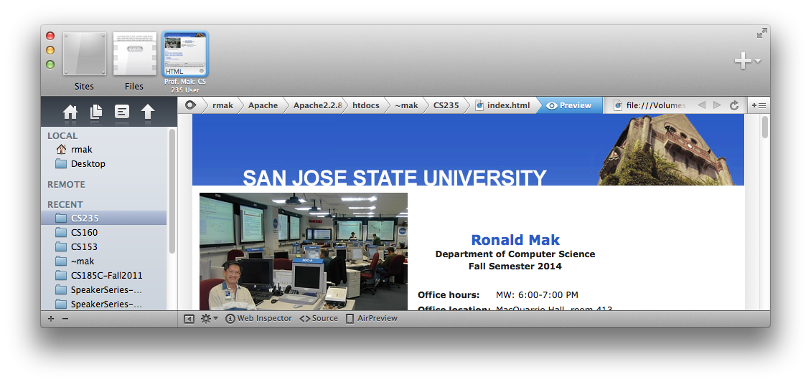
Working Memory and UI Design, cont’d
Leave breadcrumbs behind

Slide 24
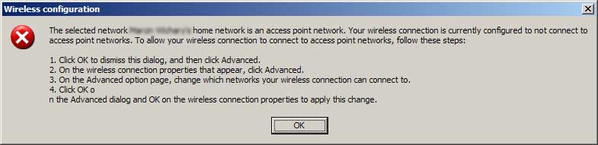
Working Memory and UI Design, cont’d
Don’t force the user to memorize instructions.
Designing with the Mind in Mind, 2nd ed. by Jeff Johnson
Morgan Kaufmann, 2014

Slide 25
Long-Term Memory
Long-term memory is a memory store (a dark warehouse).
Error-prone
Not an accurate, high-resolution recording.
Weighted by emotions
Retroactively alterable _

Slide 26
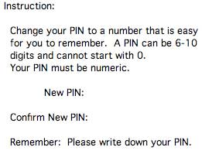
Long-Term Memory and UI Design
Do not burden long-term memory.
Example: Don’t make it impossible to create an easy-to-remember PIN.
Designing with the Mind in Mind, 2nd ed. by Jeff Johnson
Morgan Kaufmann, 2014

Slide 27
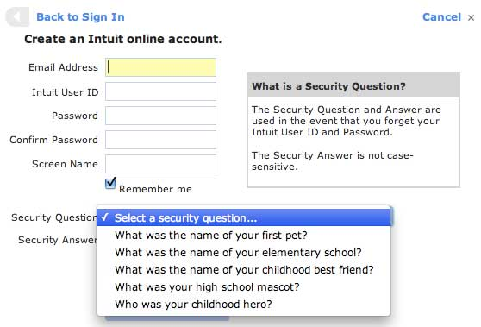
Long-Term Memory and UI Design, cont’d
Example: Users may have a hard time to come up with unique and memorable answers to standard authentication questions.
Designing with the Mind in Mind, 2nd ed. by Jeff Johnson
Morgan Kaufmann, 2014

Slide 28
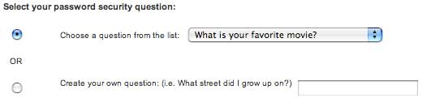
Long-Term Memory and UI Design, cont’d
Solution: Let the users pick their own questions.
Designing with the Mind in Mind, 2nd ed. by Jeff Johnson
Morgan Kaufmann, 2014

Slide 29
Attention and Goals
We focus on our goals and pay little attention to things not related to our goals.
Attention blindness
When we are occupied with a task or goal, we can fail to notice objects and events that we would otherwise notice.
Change blindness
When our attention is focused, we fail to notice change.

Slide 30
Attention and Change Blindness Videos
https://www.youtube.com/watch?v=IGQmdoK_ZfY&index=2&list=PLB228A1652CD49370

Slide 31
Recognition is Easy
Recognition = perception + long-term memory
Recognition is often very fast.
Recognize threats
Recognize faces

Slide 32
Recall is Hard
Our brains did not evolve to recall facts well.
We all hated to memorize facts in school.
Modern memory aids include:
PowerPoint slides
Account books
Address books
Calendars
Alarm clocks

Slide 33

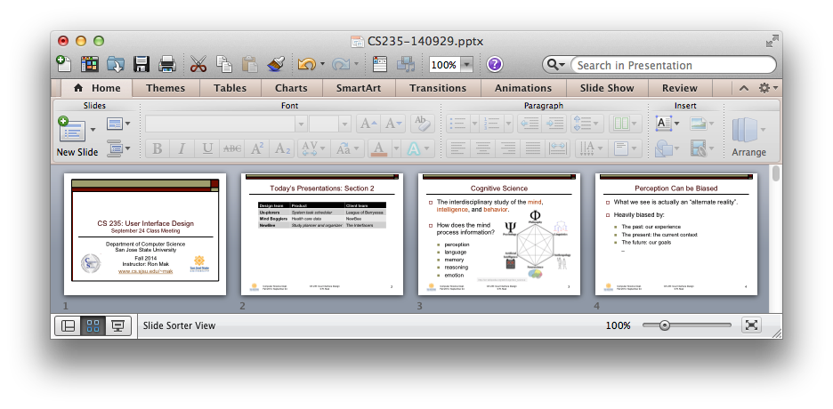
Recognition and UI Design
Docked icons convey function via recognition.
PowerPoint thumbnails provide an overview of a presentation based on recognition.

